Slide 1
Microsoft Teams
Team Collaboration Tool

Slide 2
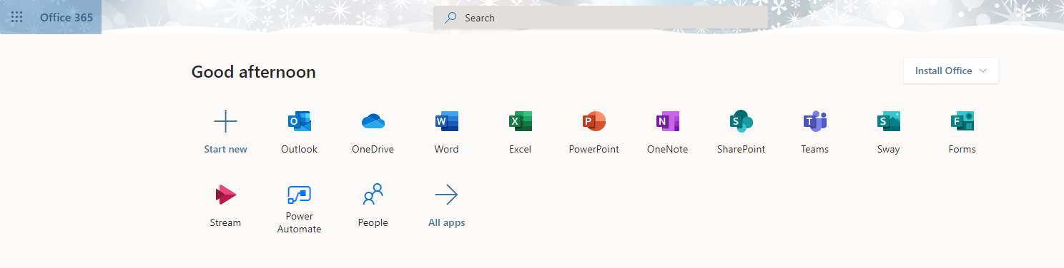
Microsoft Teams
A collaboration tool comes with Microsoft O365
Free of charge for all HKUST users

Slide 3
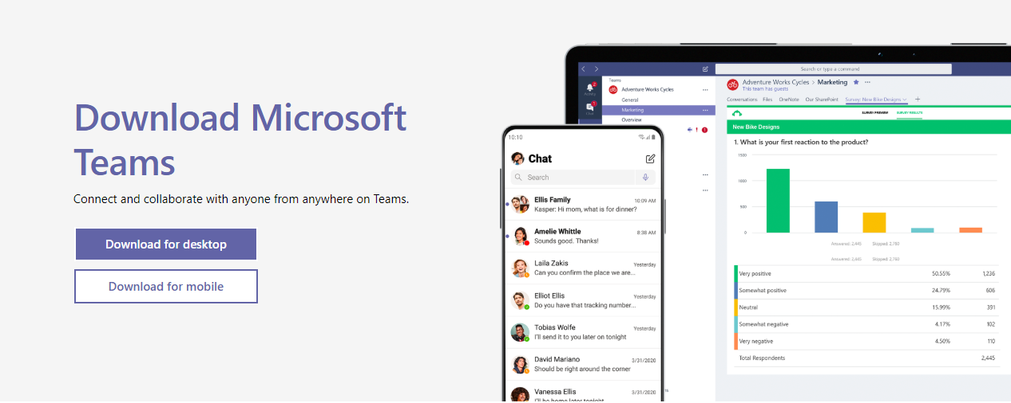
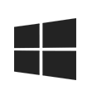
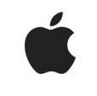






Installation of Microsoft Teams
Can access through web browsers
Windows Mac iOS Android

Slide 4
Basic Concepts and Terminology
A shared space is a Team (team site) with many members
  The person who creates the Team is the owner with most rights
  Owner can invite members to be the owner
  Invited owner would have the same rights at the owner
A person can join many independent Teams
Each Team can create Channels and a member may belong to different channels.

Slide 5
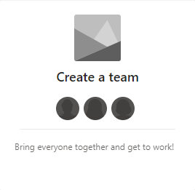
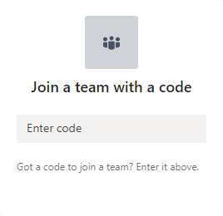
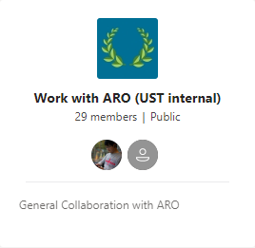
Microsoft Teams: Getting Started
First time login
  You do not need to register an account
  Login with your HKUST email address and password
You can create your own team and invite others to join your team
You can accept an invitation from another team
You can apply to join another team
Public team: every HKUST user can join
Private team: only invited users can join

Slide 6
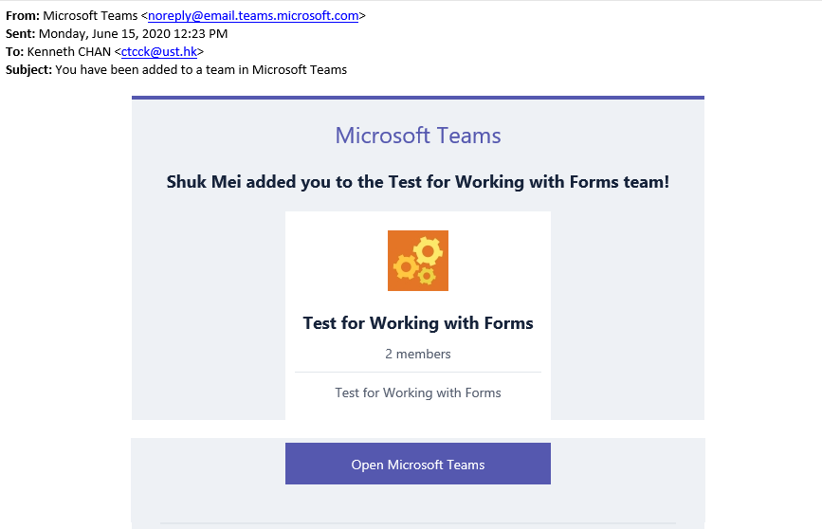
Accept an Invitation
An invitation email will be sent to the invitee.
The invitee can click Open Microsoft Teams button to accept the invitation and launch Team.

Slide 7
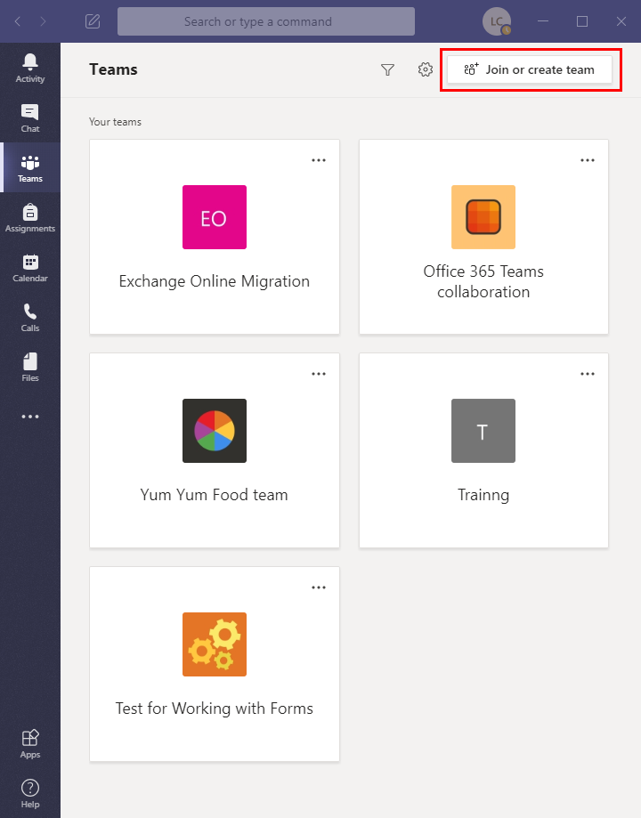
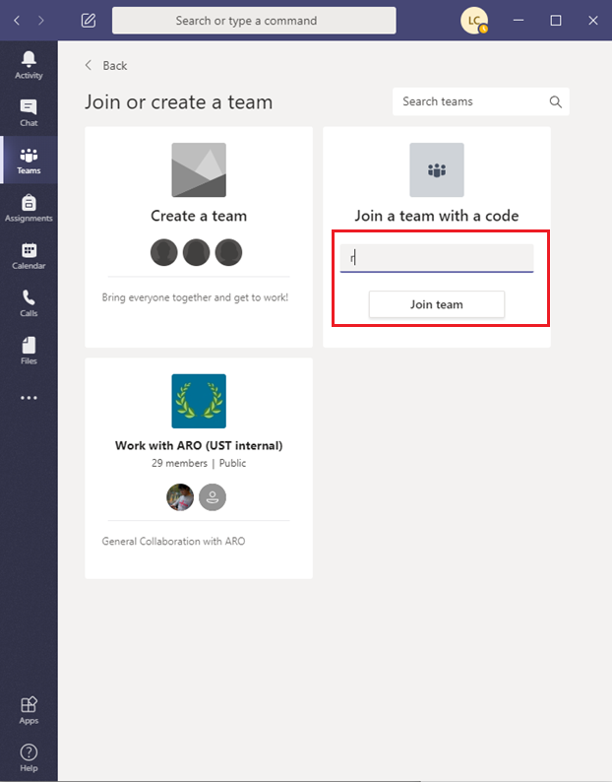
Join a Team with a Code
1. Click Join or create team button.
2. Enter the code and click Join team.

Slide 8
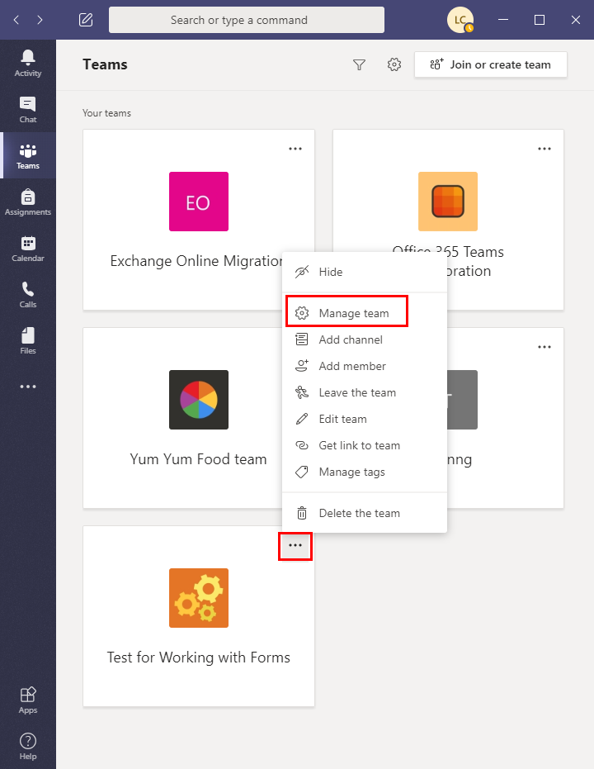
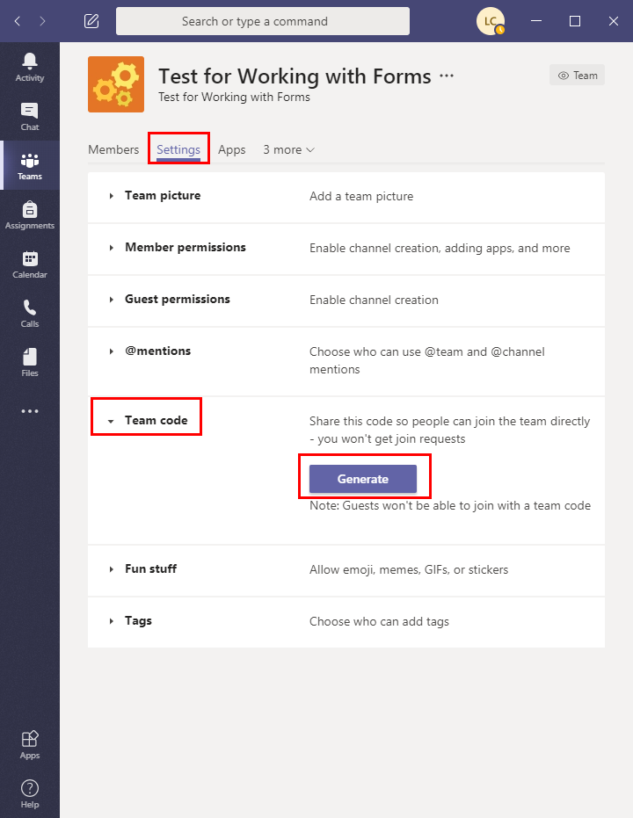
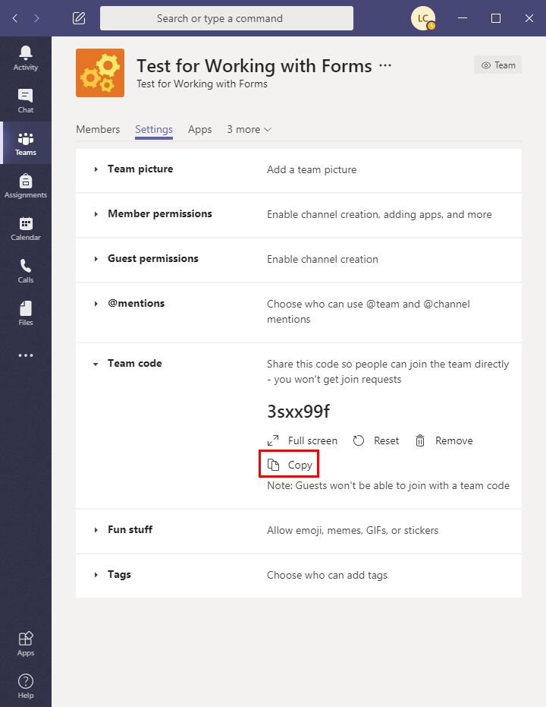
Generate Team Code (only owner can do it)
Click to select Manage team.
Go to Settings, expand Team code and click Generate button.
You may copy and send the code to invite new members.

Slide 9

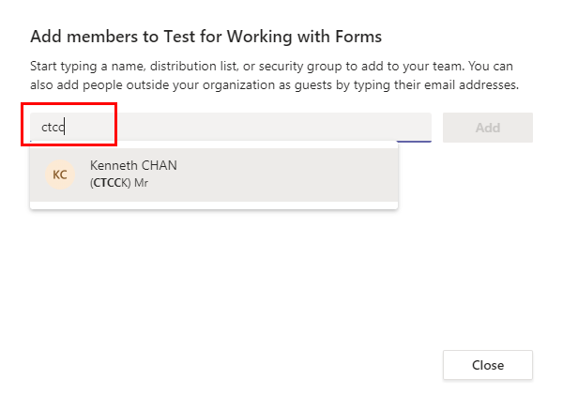
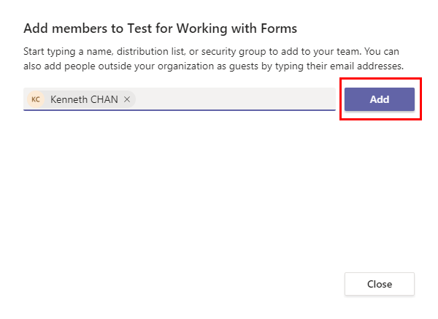
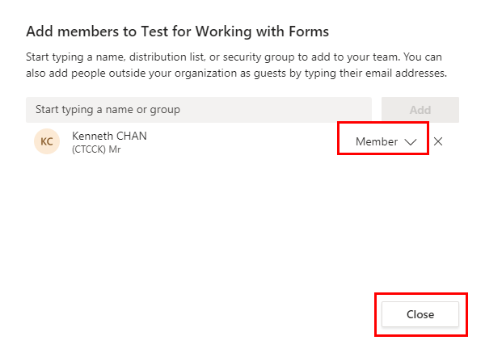
Invite a New Member
Click to select Add member
Type the ITSC account username and select the person
Click the Add button
Select membership and Click the Close button
Invitation email will be sent to the new member

Slide 10
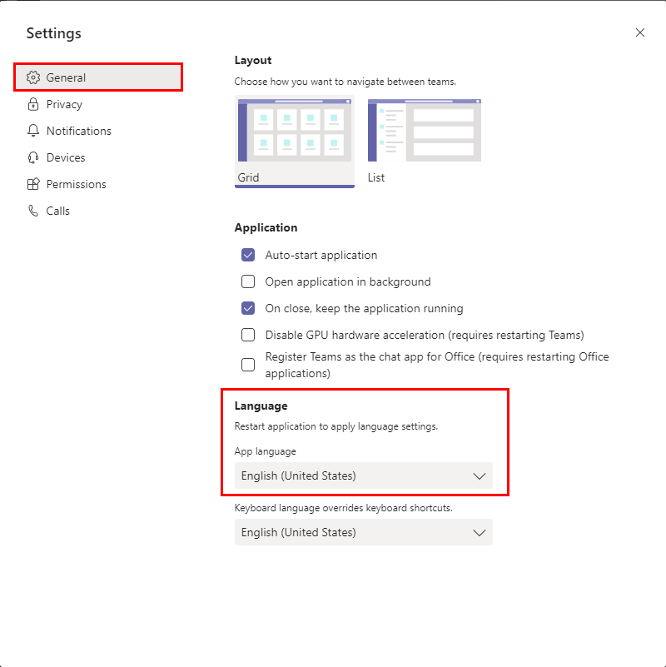
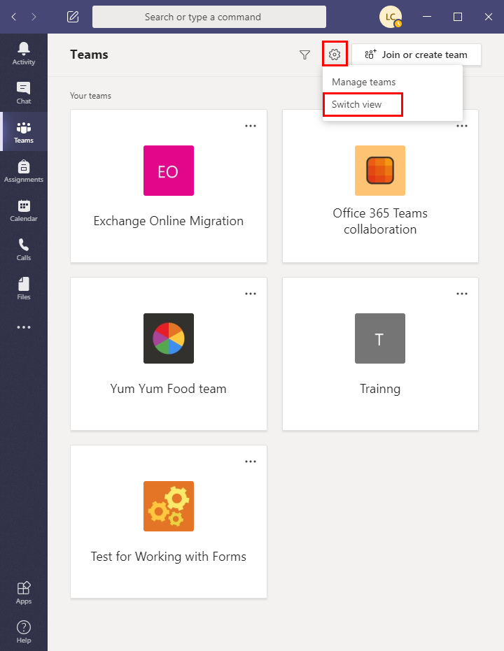
Language Selection
In General section, click the Language dropdown to select your preferred language.
Click Settings and select Switch view.

Slide 11
Files Sharing in Microsoft Teams
You do not need to send files to your Team members. Files located in Files tab of the Team can be accessed by all members of the Team.

Slide 12
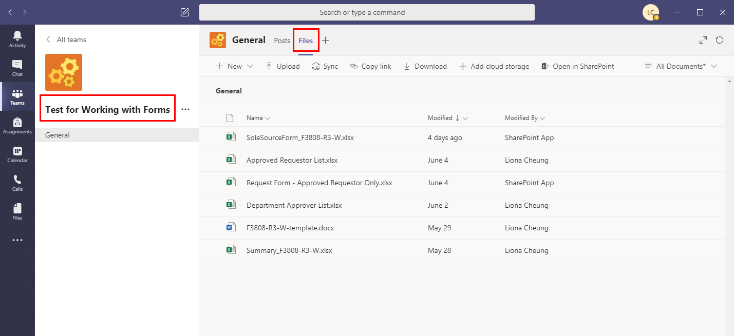
Access Files in Team
Go to Team and click the Files tab
All files of the Team are displayed here.
All members (but not guests) can edit the files.

Slide 13
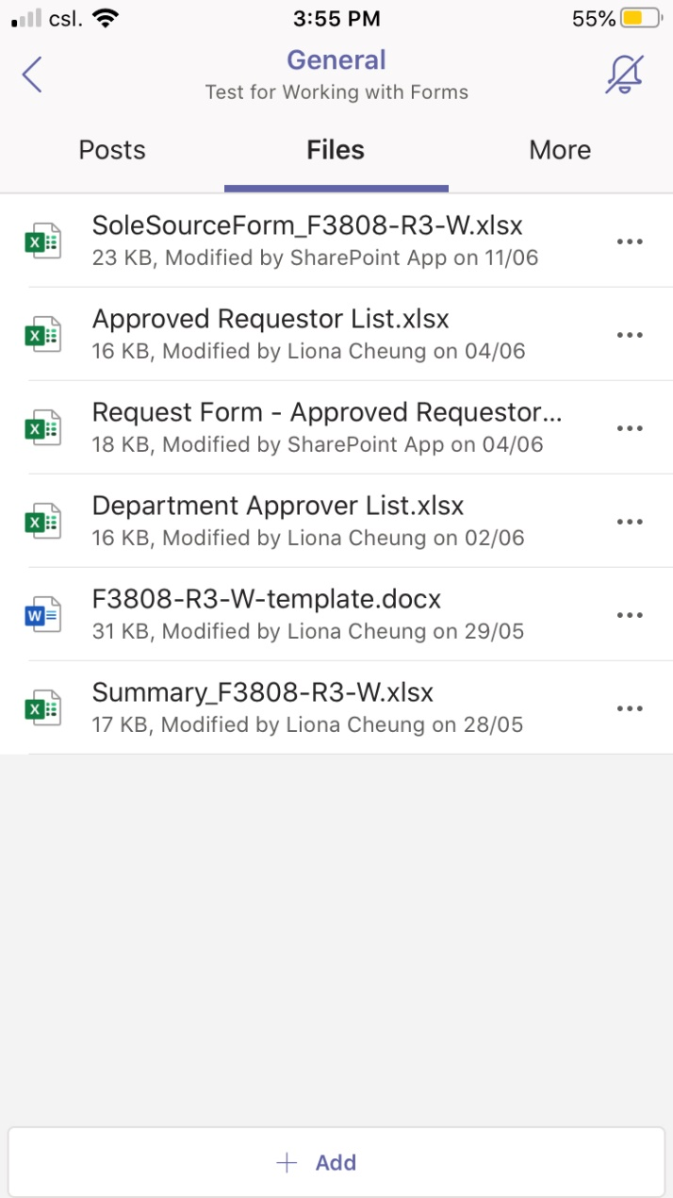
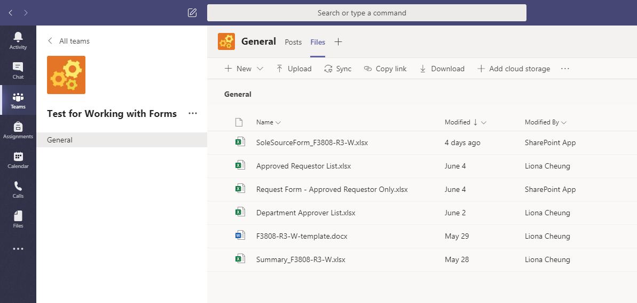
Access Files in Windows / iOS
Access files through Windows App
Access files through iOS App
iOS Version: 2.0.12

Slide 14
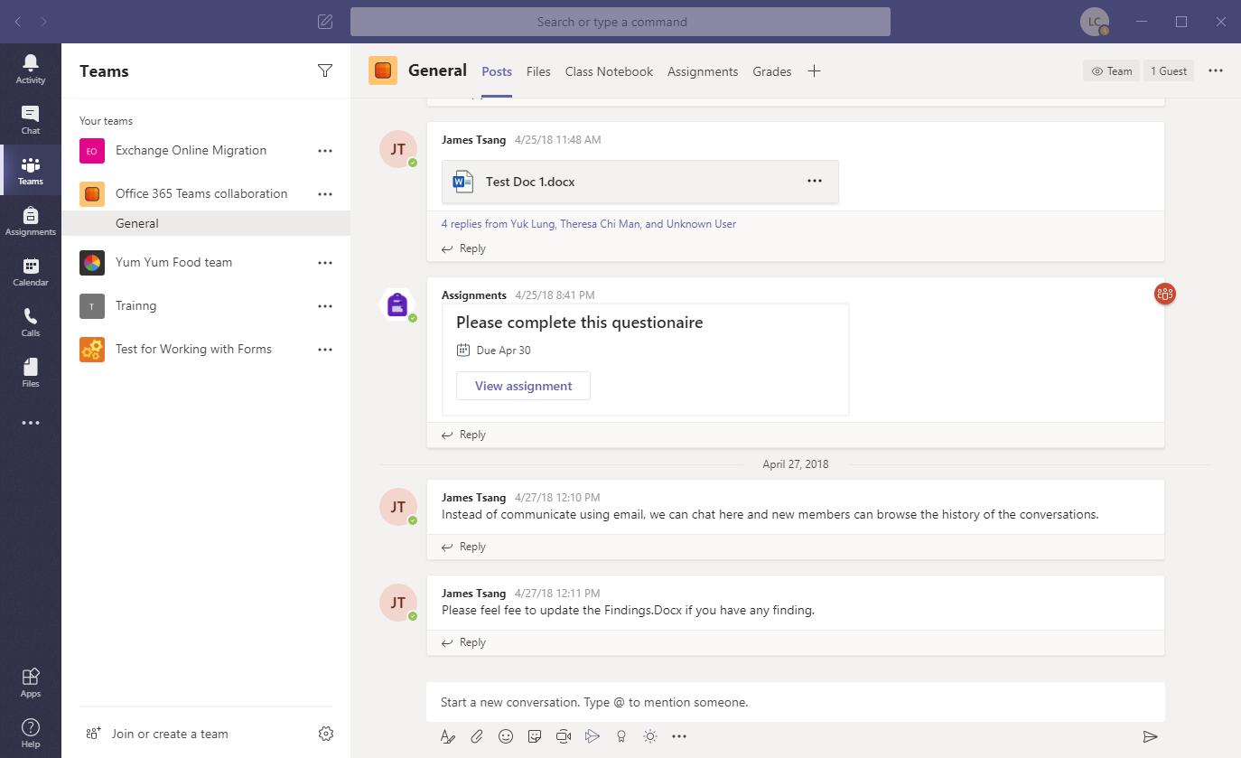
Team Space: Shared with Team Members
All chats of the Team can be found in Posts tab.
Files attached in chats are stored in Files.
There are only 3 types of rights in Team: owner, member, & guest.
One team site can have maximum 25 TB for storage. (https://itsc.ust.hk/services/general-it-services/communication-collaboration/microsoft-teams)
Chats in Team

Slide 15
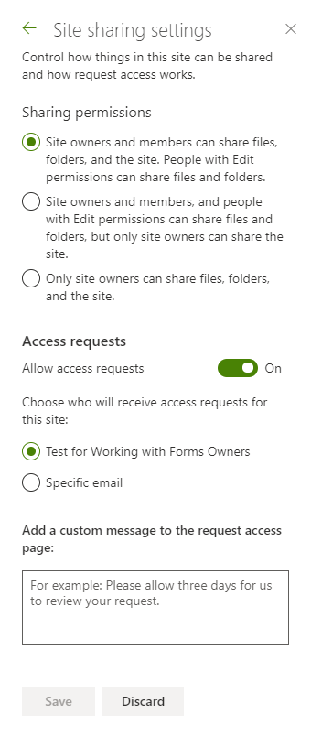
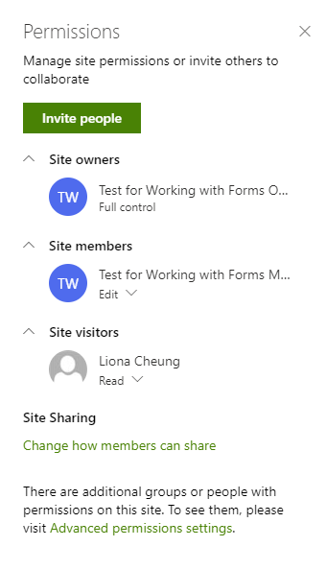
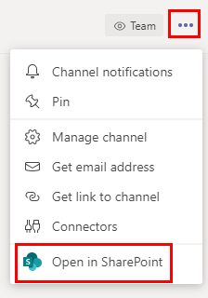
Access Permission
Permission is set for accessing the whole team site
To check permissions, you may open your Team in SharePoint
Change the permissions settings
Owners have full control
Members will have edit rights
Visitors/Guests have read-only rights

Slide 16
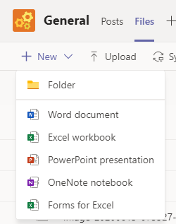
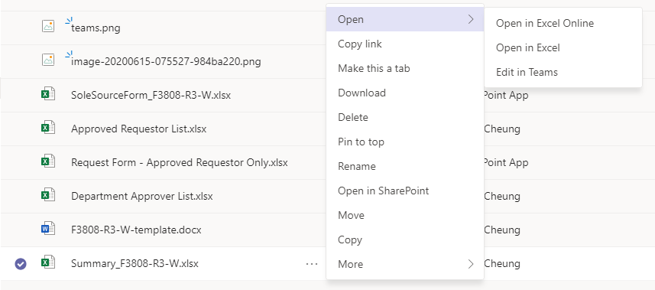
Manipulation of Shared Files
You can create new folder, Word, Excel, PowerPoint files and Forms in Team
You can also upload files from local drive to Team
You can share the file link to members, so they can access the file through the link
You can download the file to your local drive
To review file version history, you may go to SharePoint

Slide 17
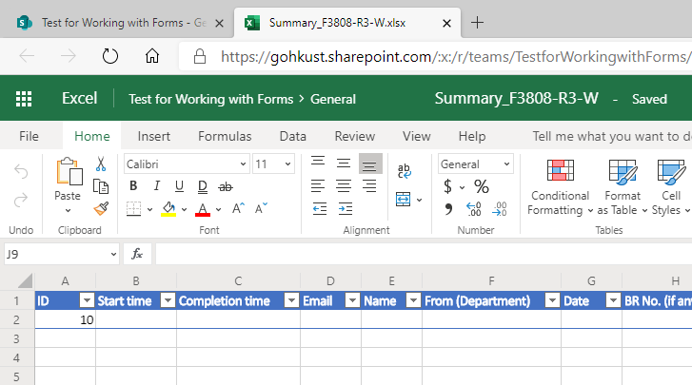
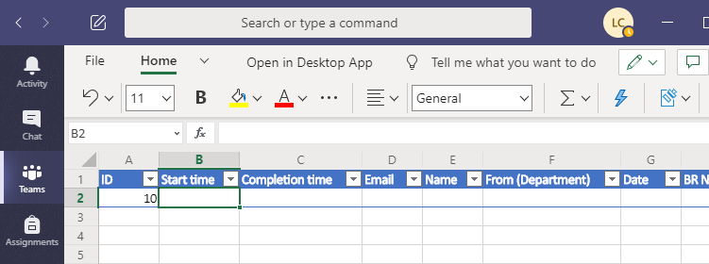
Collaboration Online Editing
You can edit the file using online app, or edit it directly in Teams
File will be saved automatically using either editing method

Slide 18
Management of Contacts & Groups
In Microsoft Teams, it uses the term Channel to represent group. Thus, members in the same Team could access different channels.

Slide 19
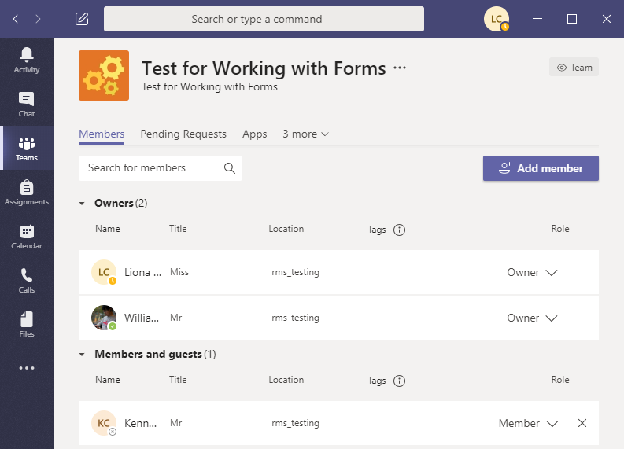
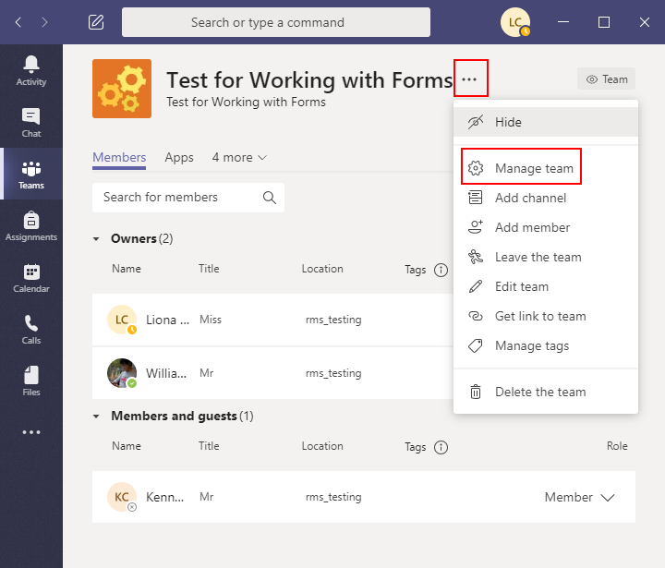
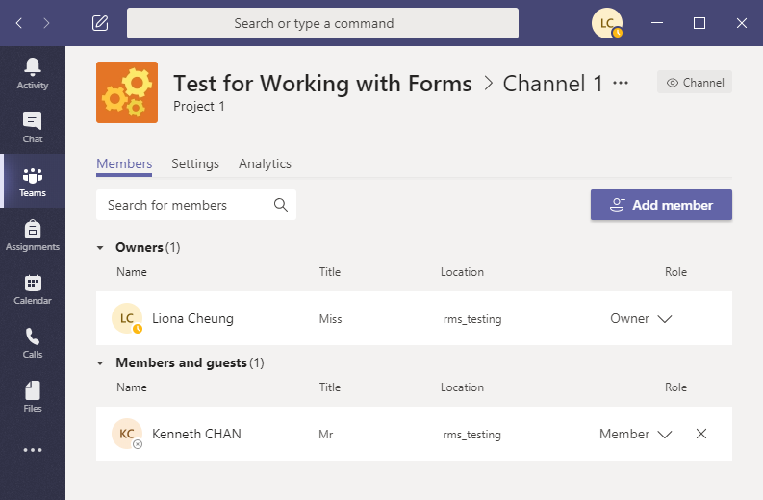
Contacts – Team Members
There are 2 members in the channel (1 owner and 1 member).
There are 3 members in the team (2 owners and 1 member).
Select Manage team to know the members of the team.

Slide 20
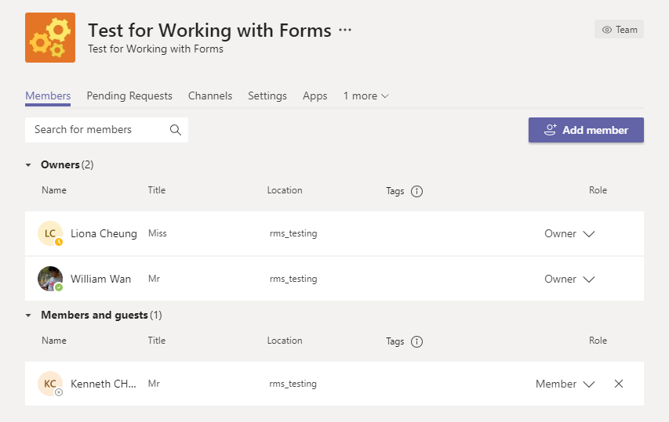
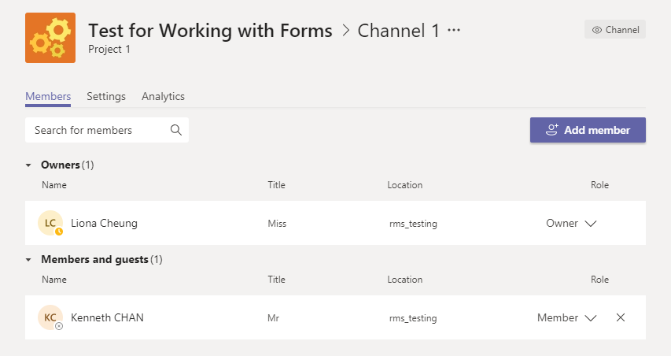
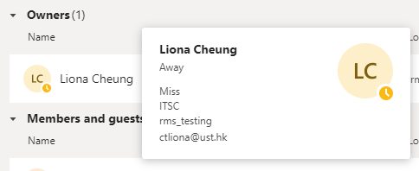
Organization Chart & Contact Profile
The Team “Test for Working with Forms” has one Channel with name “Channel 1”.
Team Members
Channel Members
The Team has 3 members
The Channel has 2 members
Point the mouse on the name of member will display the contact profile

Slide 21
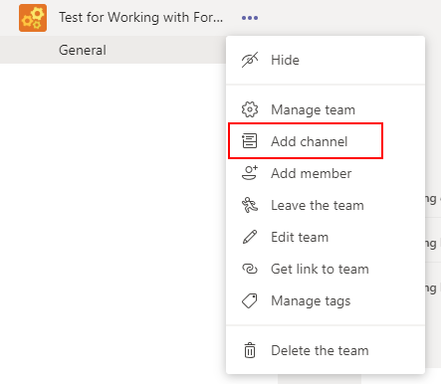
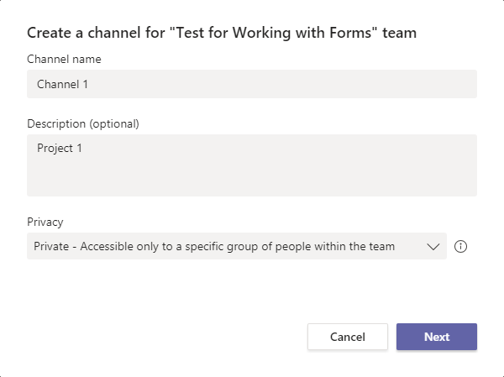
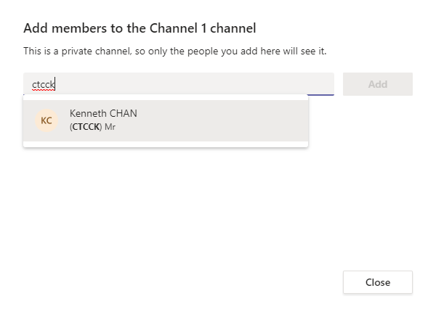
Add Channel
Click and Select Add channel
Enter Channel name and Description
Add members to channel. Only members in the team can be added into the channel.
Added member can be found in the member list

Slide 22
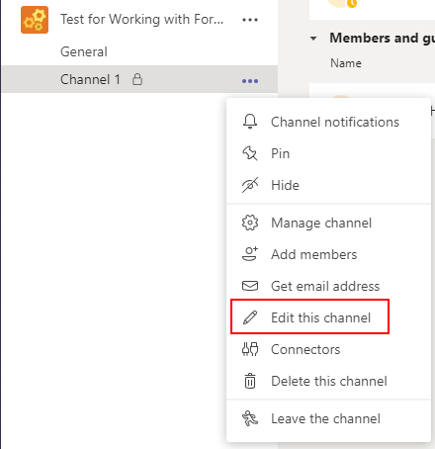
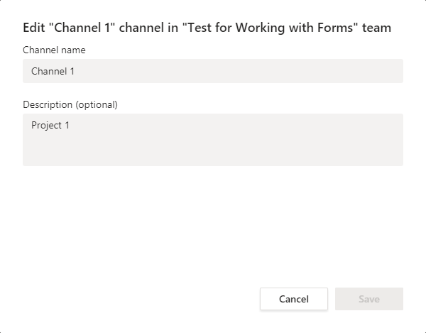
Edit Channel
Select Edit this channel
Only Channel name and Description can be modified

Slide 23
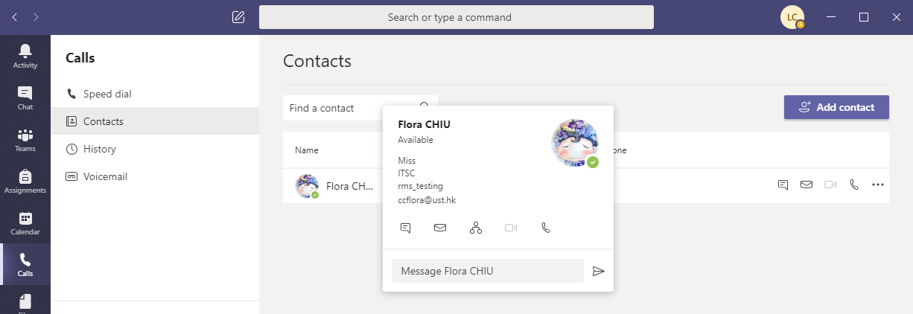
Personal Contact
Chat Email View Organization Send Message Video Call Call

Slide 24
Messaging Service
You can send message to a single person, a channel or a team

Slide 25
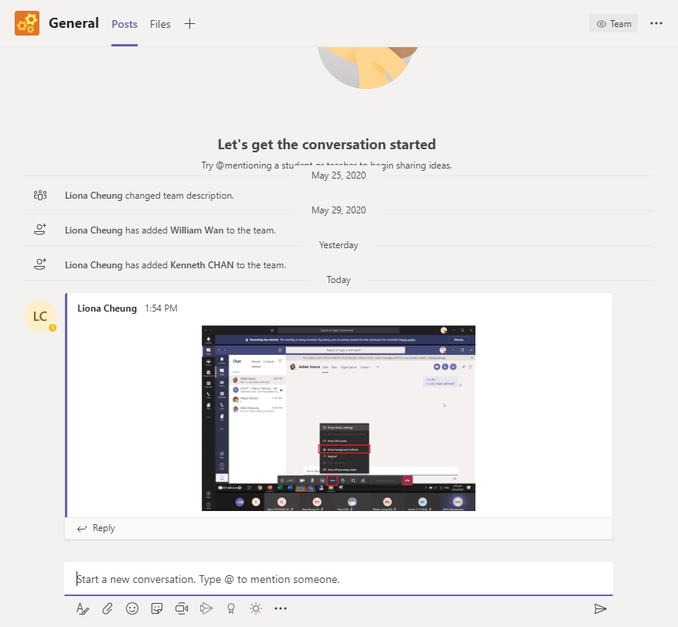
Team or Channel Communication
You can send messages to your Team or Channel members under the Posts tab. Each team or channel has its own Posts tab.
Conversation history is listed in Posts. Every member can trace the history here.
You can reply a specific message by clicking Reply
Type and send your message here. If you want to mention any member is the message, you can type “@” then name of the member.
You can attach files, emoji, stickers here, even start an online meeting too

Slide 26
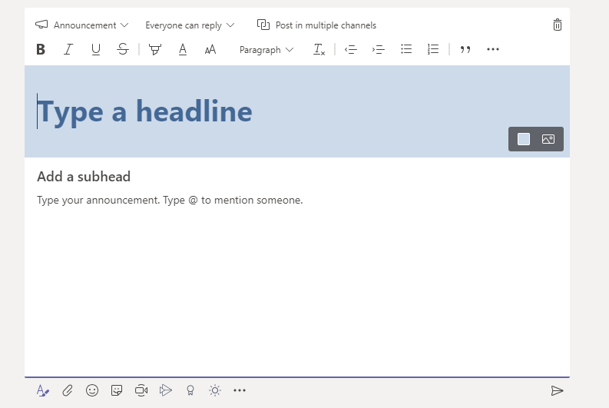
Post Announcement
2
Select Format
Switch New Conversation to Announcement
Type the headline
Type the announcement
Send the announcemnt
3
4
1
5

Slide 27
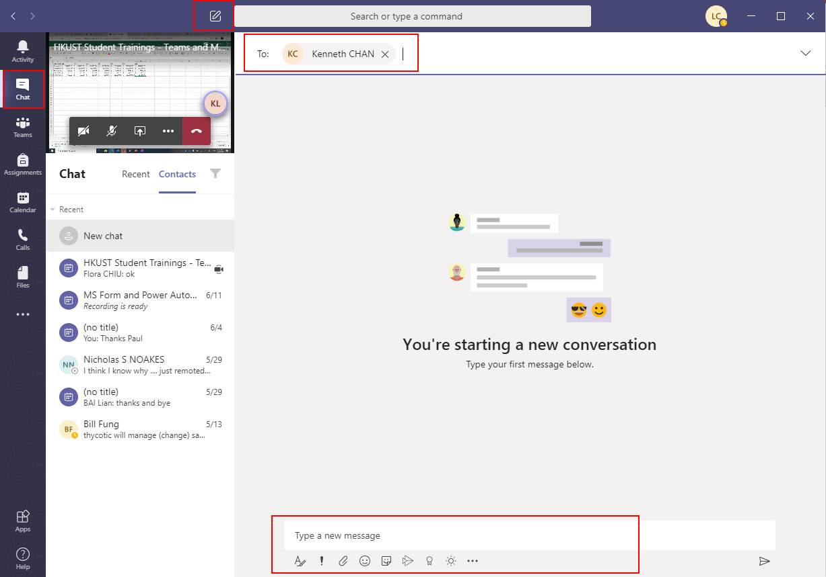
Personal Chat
2
Click Chat
Click New Chat
Enter the name of the person(s) you want to chat with
Type your message just as you do in team/channel post
1
3
4

Slide 28
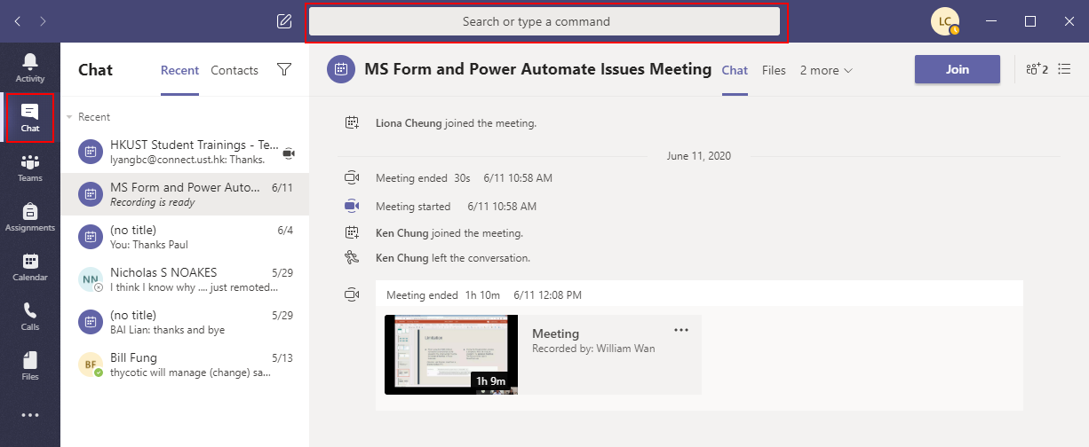
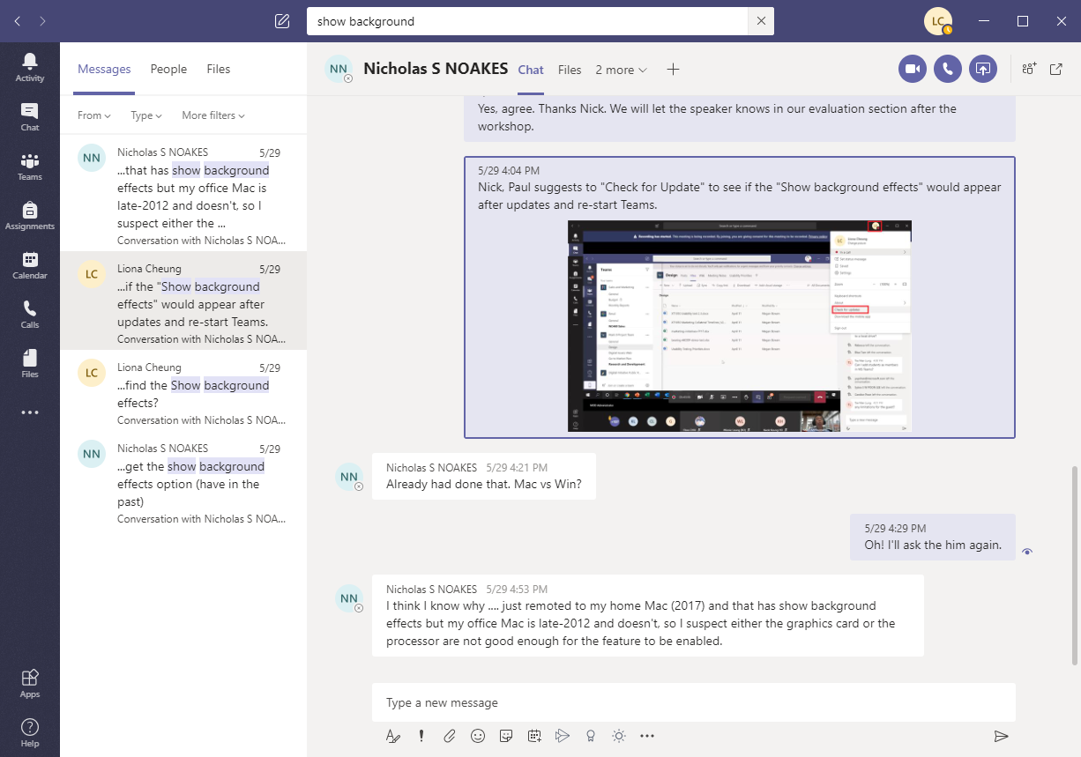
Search Chat Records
Type the keywords or phrases for searching
Search results

Slide 29
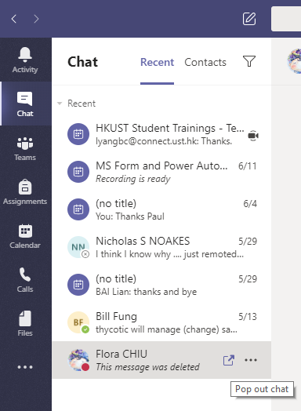
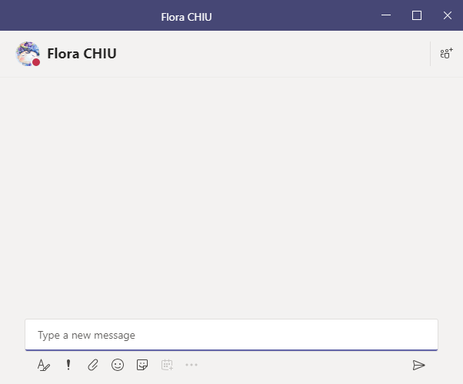
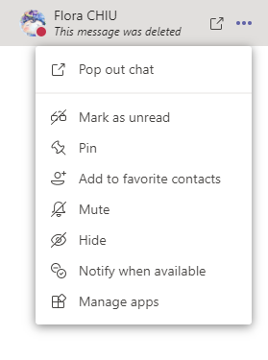
Manage Chat
Other options to manage chat
Type your message here

Slide 30
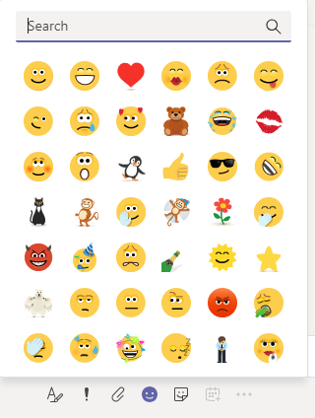





Options to Send a Message
Emoji
Set Delivery Options
Attach
Sticker
Format
When a message is sent with the Urgent delivery option, the recipient(s) would be notified every 2 mins for 20 mins. This could remind the recipient(s) to take action.

Slide 31
Workflow of Approval
This can be done by using another tool Power Automate in O365

Slide 32


Launch Power Automate
Access Office 365 (http://portal.office.com)
Login with HKUST email address and password
Select Power Automate

Slide 33

Templates
There are many templates available and you can create your approval workflow using a temple.
You can also create your workflow from scratch and save it as a template for future use.

Slide 34

Approvals
Approval > Received shows if any approval is waiting for your action.
Approval > Sent shows if any approval is requested by you.
Approval > History shows the approval history you received and sent.

Slide 35


Create an Approval Workflow
Select New > Create from template
Select Approval tab and select a suitable template

Slide 36

Design the Workflow
When an request is submitted, an email will be sent to the approver for approval
In this example, the workflow is triggered by submitting a request form.
Actions to take when the request is approved, including prepare document and send notification email.
If the request is rejected, an notification email will be sent to notify the requestor.

Slide 37


Connections in the Workflow
Different O365 tools are used in the workflow

Slide 38
Security & Privacy

Slide 39
Security & Privacy Issues
To know more about Office 365 (O365), please visit ITSC website:
https://itsc.ust.hk/services/general-it-services/user-account/office-365-for-staff/
To access O365, you are required to login in with your HKUST email address, password, and authenticate through the DUO Mobile app for 2FA authentication.
There are only 3 types of access rights in Microsoft Teams: owner (full control), member (edit rights), and guest (read-only)
Be careful to grant rights to different users

Slide 40

Private Cloud – OneDrive for Business
Your private cloud in O365 is OneDrive for Business

Slide 41


Log or Analytics
Microsoft Teams do not have administrator log, but there is an Analytics page showing the activity summary of the team.

Slide 42
Other Features

Slide 43


Other Features
You can add many different apps to your team as a tab, including apps in O365 and many other 3rd party apps

Slide 44


Calendar
Calendar is totally integrated with Outlook Calendar!!!

Slide 45


Schedule Meeting
You can schedule a meeting in Microsoft Teams
Meeting invitation will be sent through Outlook

Slide 46

Video Conference
You can share your screen, hide your background, etc. in video conference

